Slide 1
ANGULAR AUTHENTICATION AND AUTHORIZATION
Presentator: MyHN

Slide 2
Agent
Token-Based Authentication
JSON Web Token (JWT)
Angular Authentication and Authorization
Demo

Slide 3
Token-Based Authentication
What is token-based authentication?
Pros and cons
How Token-Based Authentication Works

Slide 4
I. Token-Based Authentication
1. What is token-based authentication?
Allow users to enter their username and password in order to obtain a token which allows them to fetch a specific resource - without using their username and password.
Once their token has been obtained, the user can offer the token - which offers access to a specific resource for a time period - to the remote site.

Slide 5
I. Token-Based Authentication
2. Pros and cons
Pros
Cross-domain / CORS: its work any server on any domain
Stateless : The rest of the state lives in cookies or local storage on the client side.
Decoupling: you are not tied to any particular authentication scheme
Performance: Finding a session on database is likely to take more time than calculating an HMACSHA256 to validate a token and parsing its contents.

Slide 6
I. Token-Based Authentication
2. Pros and cons
Cons
Cannot manage client from the server.
Identifying each client per user is not possible.
Have risk if private key is leaked.

Slide 7
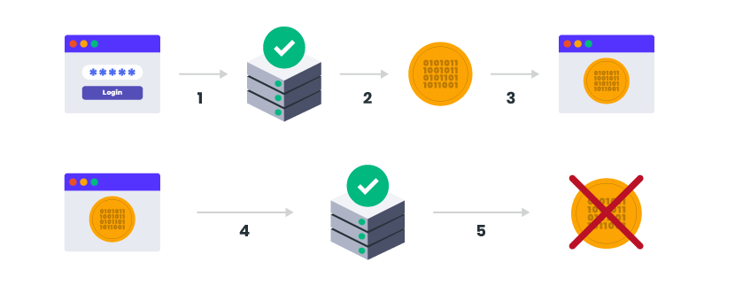
I. Token-Based Authentication
3. How Token-Based Authentication Works

Slide 8
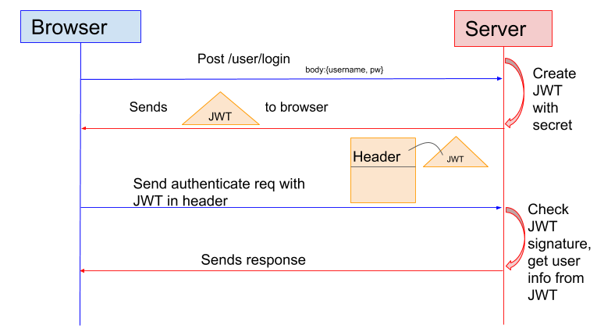
I. Token-Based Authentication
3. How Token-Based Authentication Works

Slide 9
JSON Web Token (JWT)
What is JSON Web Token?
JSON Web Token structure
Some JWT attributes

Slide 10
I. Token-Based Authentication
1. What is token-based authentication?
JSON Web Token (JWT) is an open standard (RFC 7519) that defines a compact and self-contained way for securely transmitting information between parties as a JSON object.
This information can be verified and trusted because it is digitally signed.
JWTs can be signed using a secret (with the HMAC algorithm) or a public/private key pair using RSA or ECDSA.

Slide 11
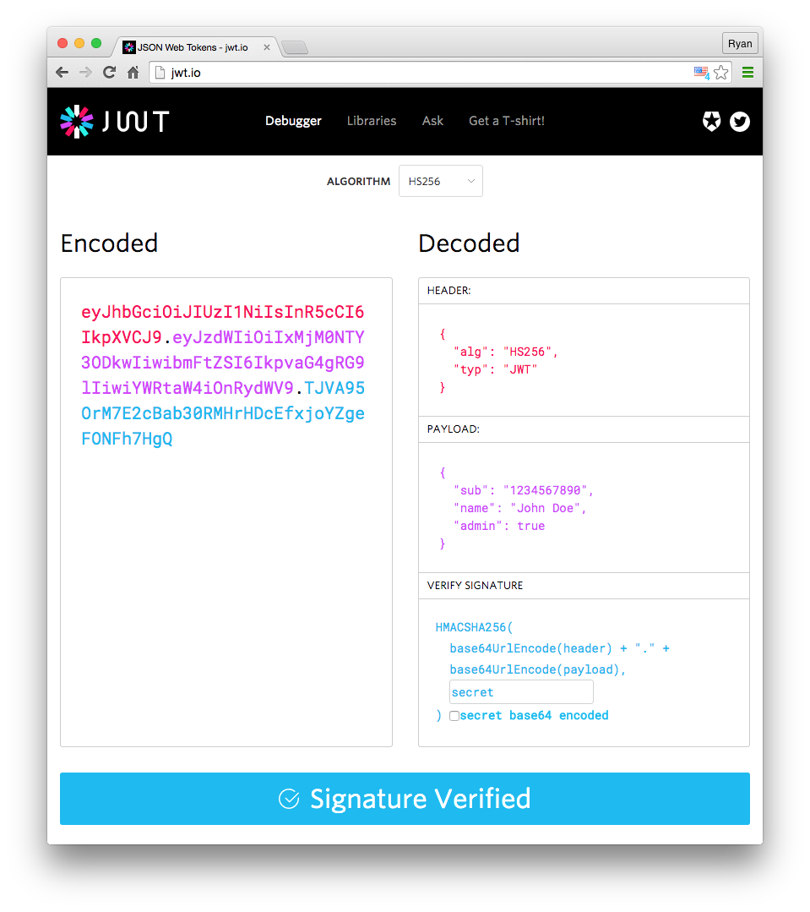
I. Token-Based Authentication
2. JSON Web Token structure
Header
Payload
Signature

Slide 12
I. Token-Based Authentication
3. Some JWT attributes
Iss: The issuer of the token
Sub: The subject of the token
Aud: The audience of the token
Exp: This will define the expiration date
Nbf: Defines the time before which the JWT MUST NOT be accepted for processing
Iat: The time the JWT was issued. Can be used to determine the age of the JWT
Jti: Unique identifier for the JWT. Can be used to prevent the JWT from being replayed. This is helpful for a one time use token.

Slide 13
Angular Authentication and Authorization
HTTP Interceptors
Router Guards

Slide 14
III. Angular Authentication and Authorization
1. HTTP Interceptors
Interceptors have been used to pre-process and post-process the HTTP request before sending and after getting response from the server.
Interceptors can be used in two different phases in a life cycle of an HTTP request to a server, which are:
- Before making the request server:
- After Getting the response from server:

Slide 15
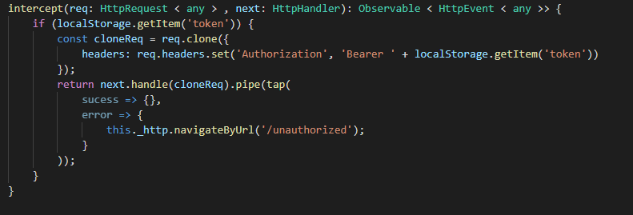
III. Angular Authentication and Authorization
1. HTTP Interceptors

